Slide 1

Project – Bike Collision Detection
Lesson 18
Container and Program development

Slide 2
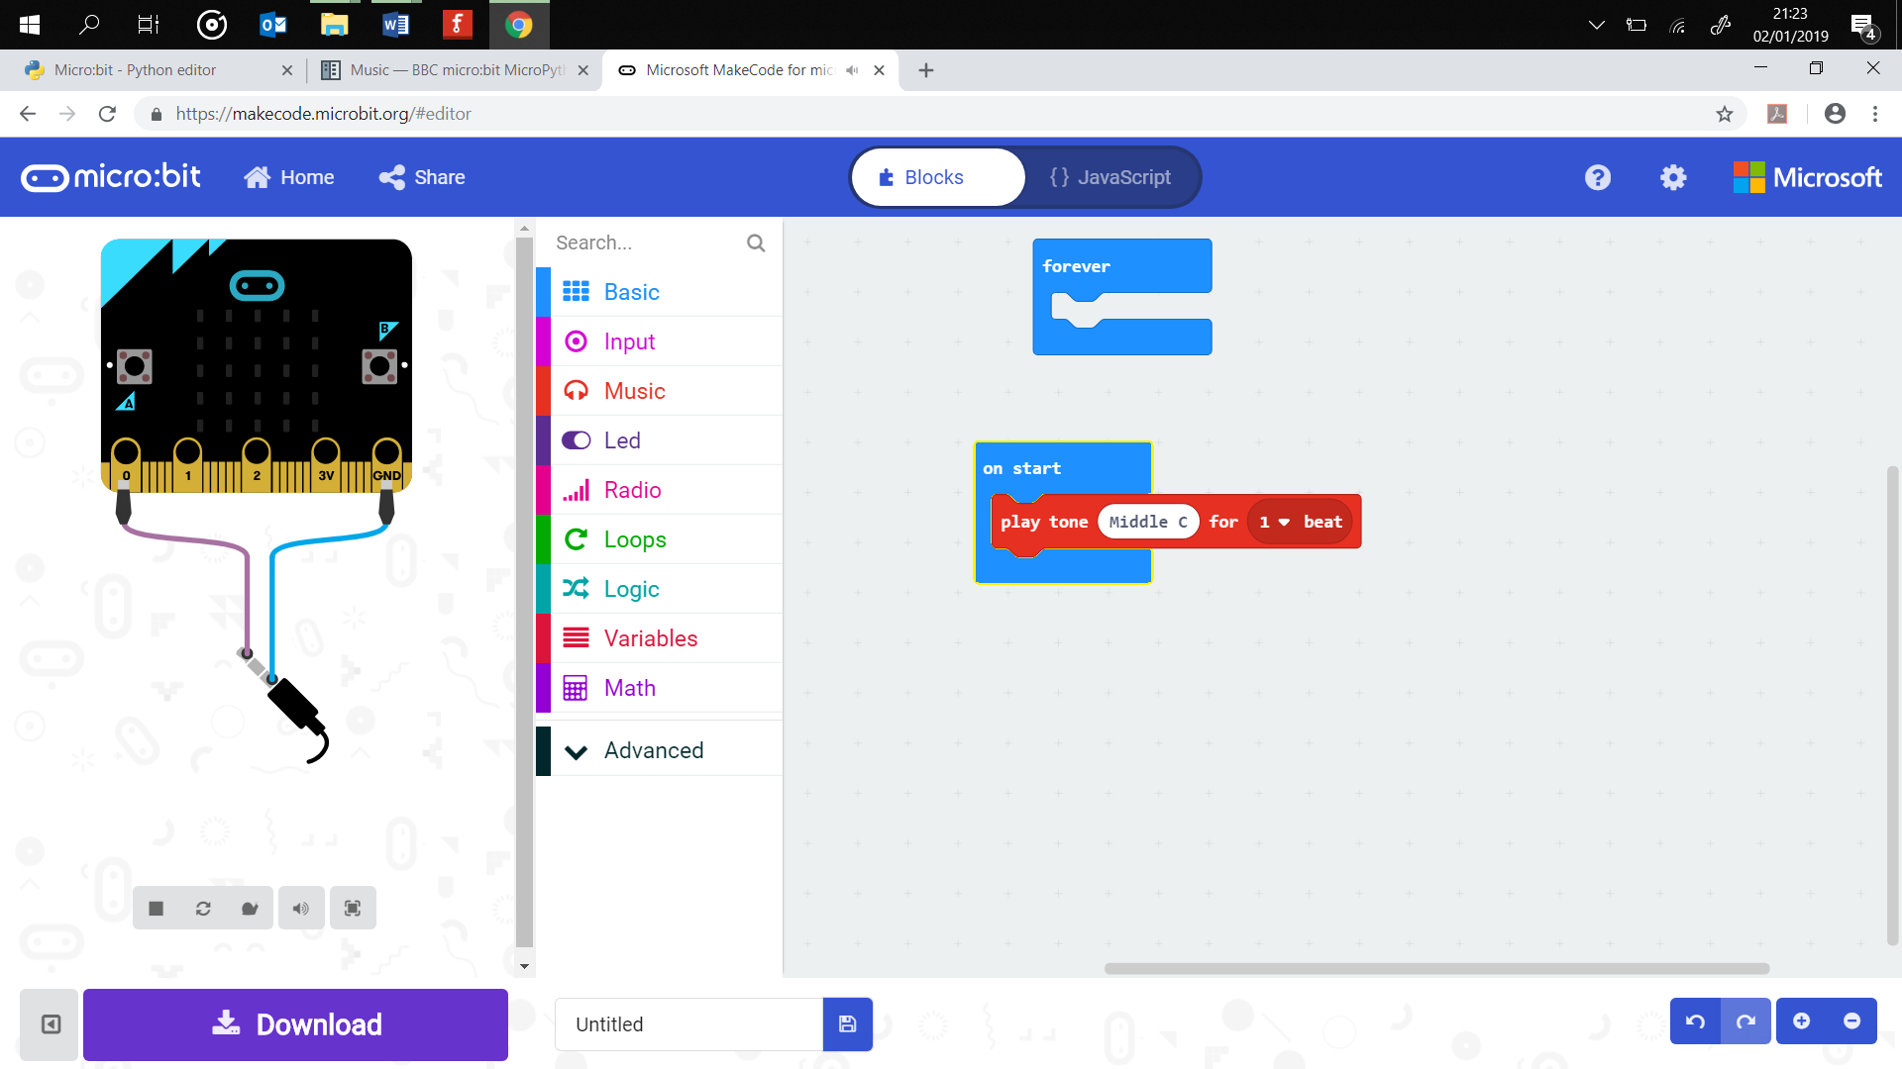
Starter
Label the diagram below with the x-, y- and z-axis

Slide 3
Success Criteria
The micro:bit responds to acceleration on one of the axes, x, y or z
The micro:bit responds to acceleration on a combination of two of the axes, x, y or z
The micro:bit responds to acceleration on all three axes
The responses are standard, LED or scrolling text message
The response uses the music or speech warnings
The values used are suitable and tested
You stay safe on your bike

